Slide 1
Interfaces
Sara Muneeb
sara.muneeb@cuilahore.edu.pk
Computer Science Department

Slide 2
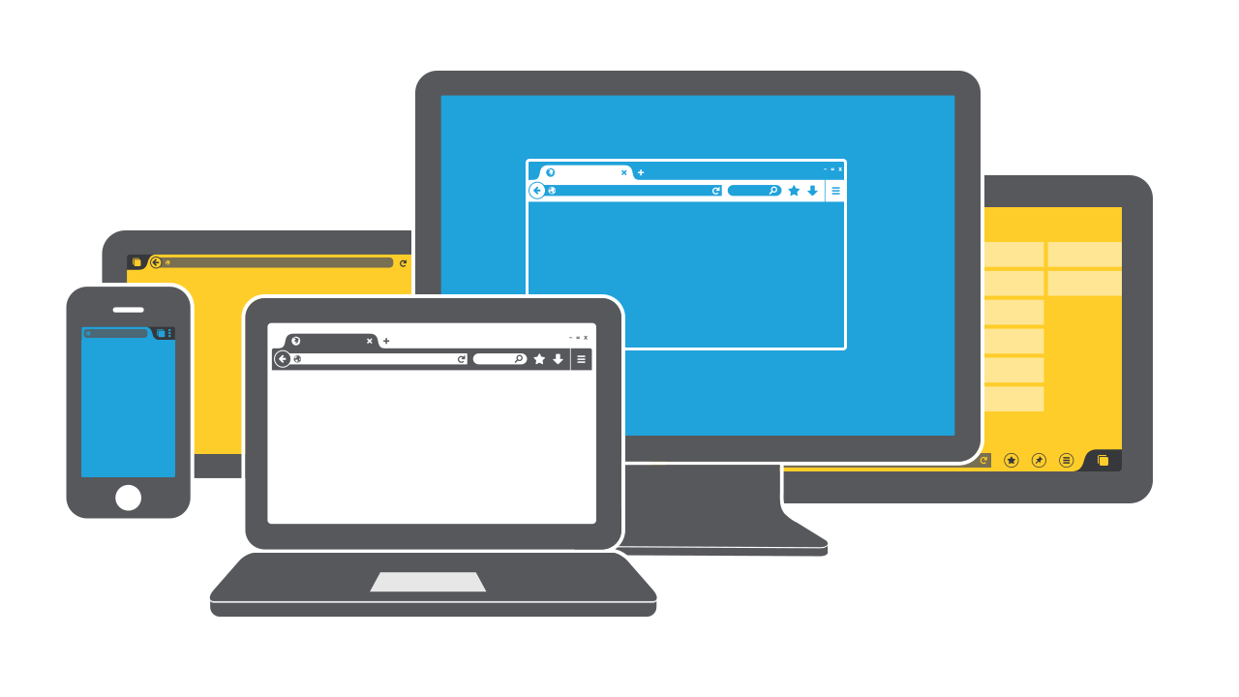
Introduction
An interface is a portal for interaction between two entities.

Slide 3
Interface Types
Command Line | Graphical
Multimedia | VR
Web | Mobile
Appliance | Voice
Pen | Touch
Gesture | Haptic
Multimodal | Sharable
Tangible | AR
Wearable | Robots and Drones
Brain Computer Interaction | Smart

Slide 4
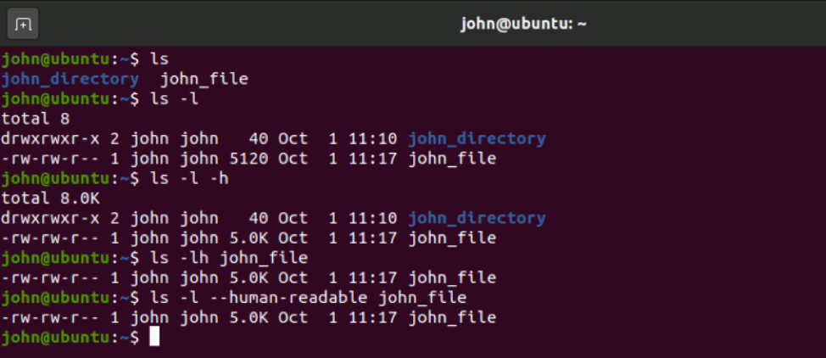
Command Line Interfaces

Slide 5
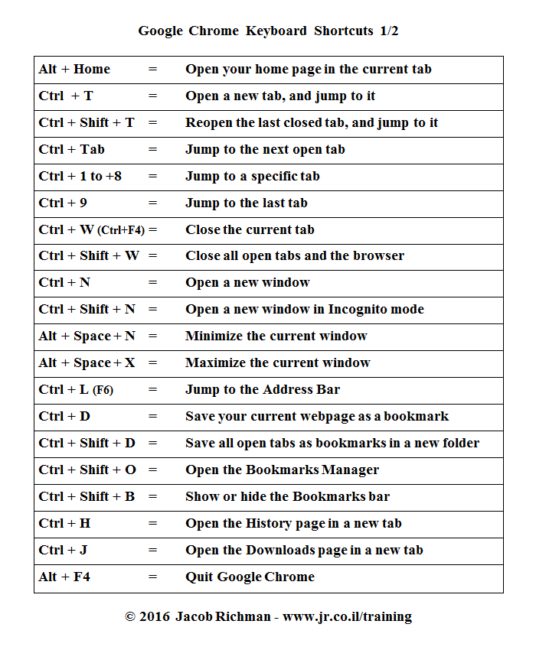
Command Line Interfaces

Slide 6
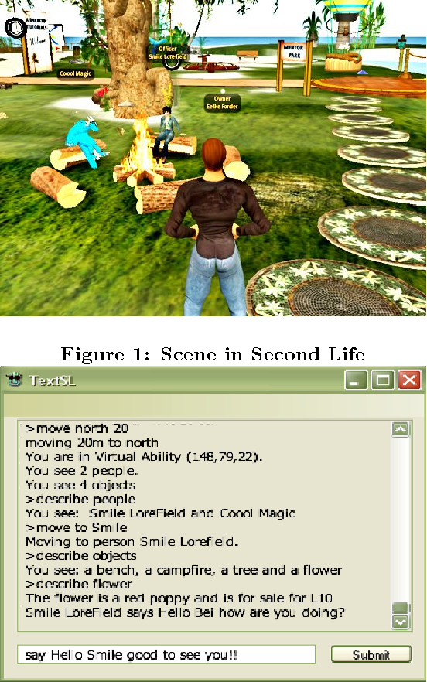
Command Line Interfaces
Second Life command-based interface for visually impaired users

Slide 7
Graphical User Interfaces
The original GUI was called WIMP
Windows: Sections of the screen that can be scrolled, stretched, overlapped, opened, closed, and moved using a mouse
Icons: Pictograms that represent applications, objects, commands, and tools that are opened or activated when clicked on
Menus: Lists of options that can be scrolled through and selected in the way a menu is used in a restaurant
Pointing device: A mouse controlling the cursor as a point of entry to the windows, menus, and icons on the screen

Slide 8
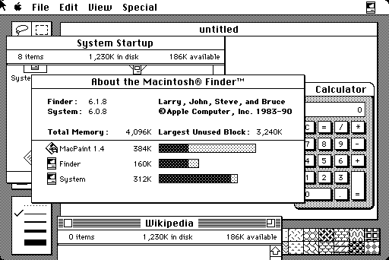
Graphical User Interfaces
The boxy look of the first generation of GUIs

Slide 9
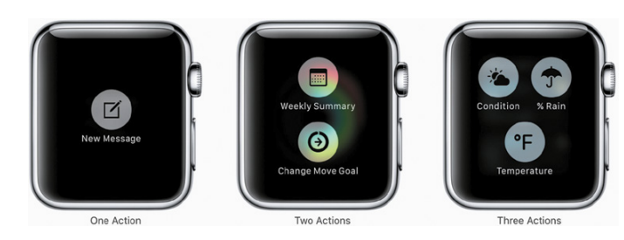
WIMP/GUI
Simple smartwatch menus with one, two, or three options

Slide 10
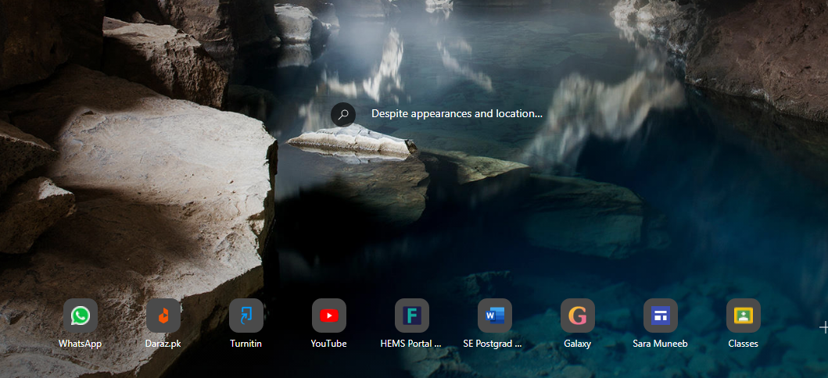
Windows Design
Microsoft Edge browser showing thumbnails of top sites visited and suggested highlight pages.

Slide 11
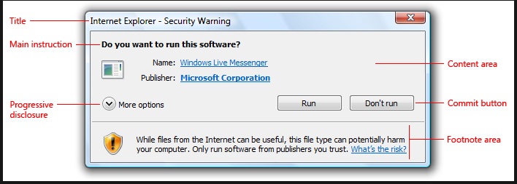
Dialogue Box
Confirmations, error messages, checklists, and forms are presented through dialog boxes. Information in the dialog boxes is often designed to guide user interaction, with the user following the sequence of options provided.

Slide 12

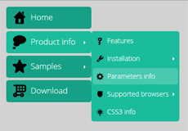
Menu Design
Flat menus are good at displaying a small number of options at the same time or where the size of the display is small.
Expanding menus enable more options to be shown on a single screen than is possible with a single flat menu list.

Slide 13
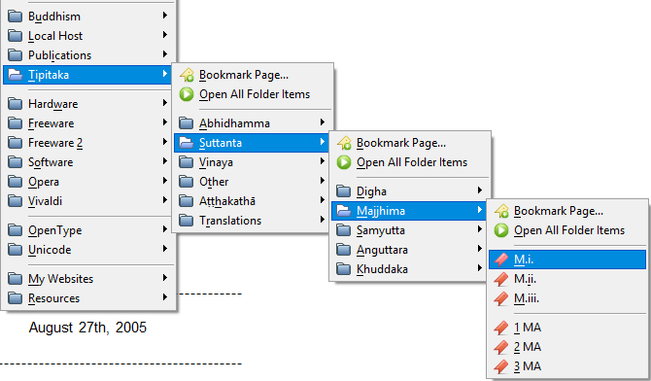
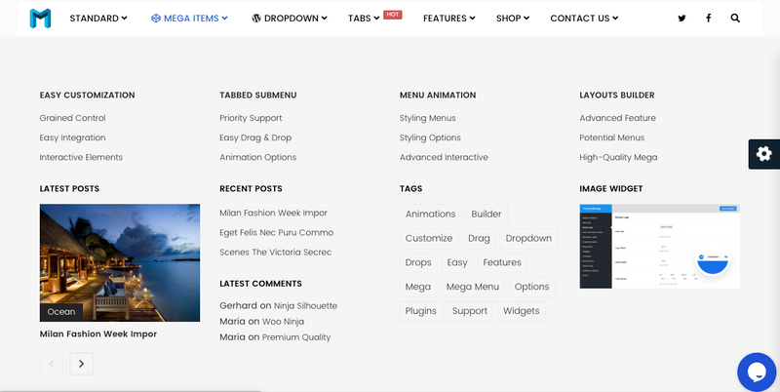
Menu Design
Cascading menu provides secondary and even tertiary menus to appear alongside the primary active drop-down menu.
Mega menu, in which many options can be displayed using a 2D drop-down layout.

Slide 14
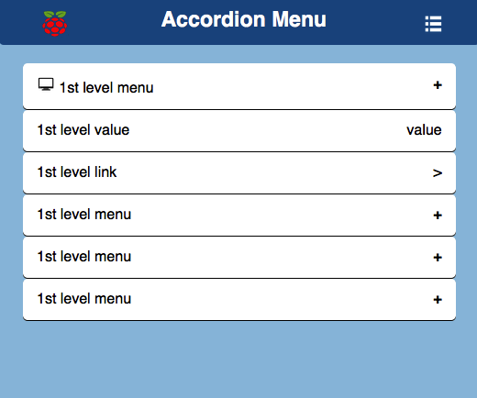
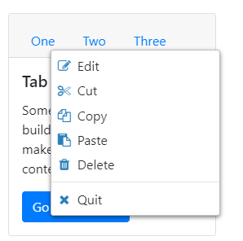
Menu Design
Collapsible menus provide an alternative approach to expanding menus in that they allow further options to be made visible by selecting a header.
Contextual menus provide access to often-used commands associated with a particular item, for example, an icon.

Slide 15
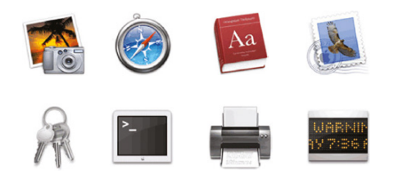
Icon Design
Isomorphic : have direct mapping between what is represented and how it is represented.
Analogies, associations and conventions: a combination of objects and symbols that captures the salient part of the action
Two styles of Apple icons used to represent different kinds of functions

Slide 16
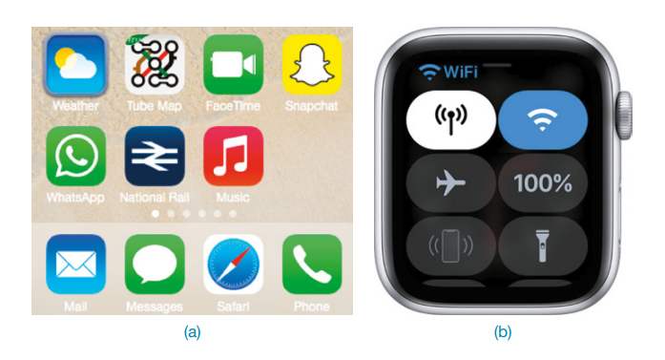
Icon Design
2D icons designed for (a) a smartphone and (b) a smartwatch

Slide 17
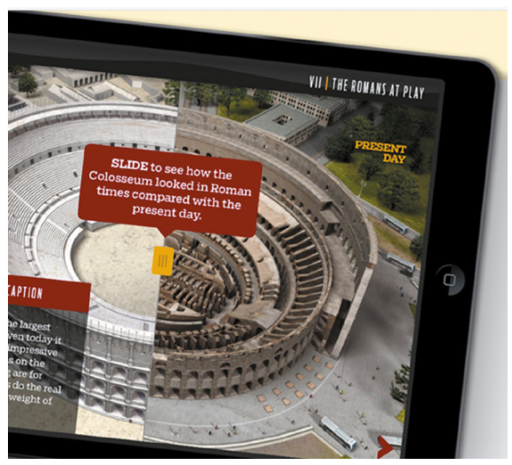
Multimedia
Multimedia, as the name implies, combines different media within a single interface, namely, graphics, text, video, sound, and animation, and links them together with various forms of interactivity.
An example of a multimedia learning app designed for tablets A

Slide 18
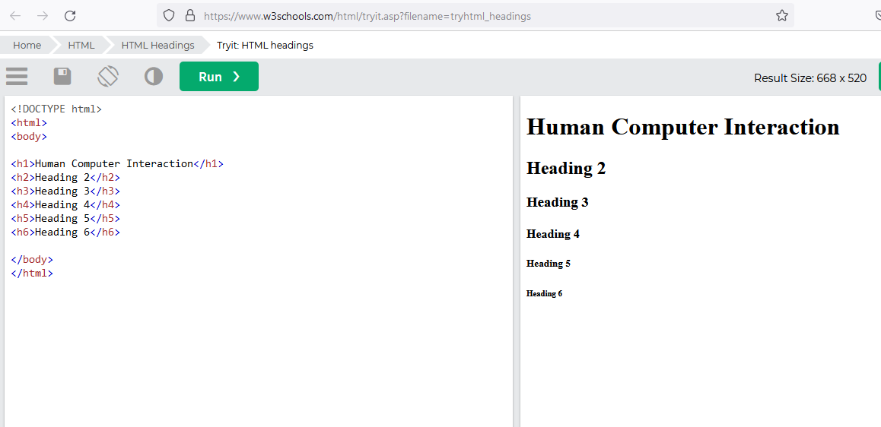
Dynalinking
Where information depicted in one window explicitly changes in relation to what happens in another.

Slide 19
Other Examples
ABCmouse: Educational Games, Books, Puzzles & Songs for Kids & Toddlers
First Person: Donald Norman, Defending Human Attributes in the Age of the Machine on Vimeo

Slide 20
Virtual Reality
The illusion of participation in a synthetic environment rather than external observation of such an environment. (Gigante, 1993)
The 3D graphics can be projected onto Cave Automatic Virtual Environment (CAVE) floor and wall surfaces, desktops, 3D TV, headsets, or large shared displays, for instance, IMAX screens.
Presence, in this case, means “a state of consciousness, the (psychological) sense of being in the virtual environment

Slide 21
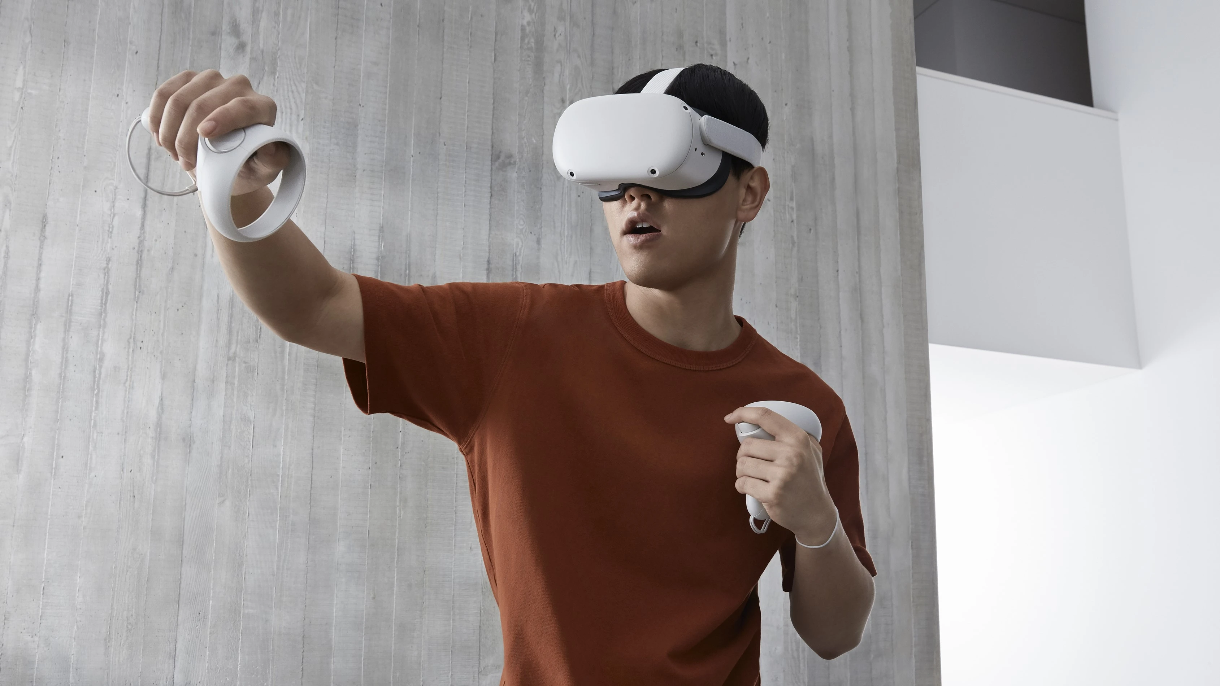
Virtual Reality
Different viewpoints : DOOM (1st person view) / Tomb Raider (Avatar)
Advance headtsets: Oculus Quest 2, HTC Vive, Samsung Gear VR

Slide 22
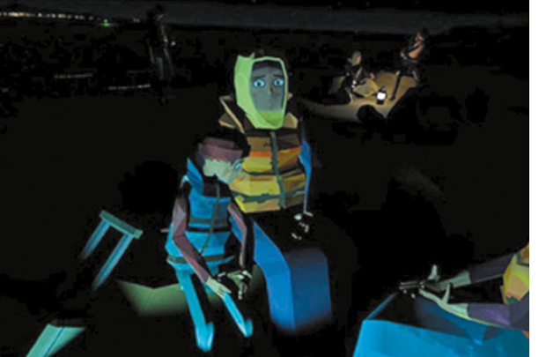
Other Examples
Magic Leap Studios | Project Create
We Wait - Trailer for New Interactive VR Project
iFLY Virtual Reality

Slide 23
Website Design
To make them applicable to website design, focusing on simplicity, feedback, speed, legibility, and ease of use.
The use of graphical elements (such as background images, color, bold text, and icons) can make a website look distinctive, striking, and pleasurable for the user when they first view it and also to make it readily recognizable on their return.

Slide 24
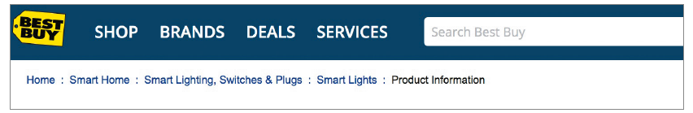
Breadcrumb Navigation
Breadcrumbs are category labels that appear on a web page that enable users to peruse other pages without losing track of where they have come from.

Slide 25
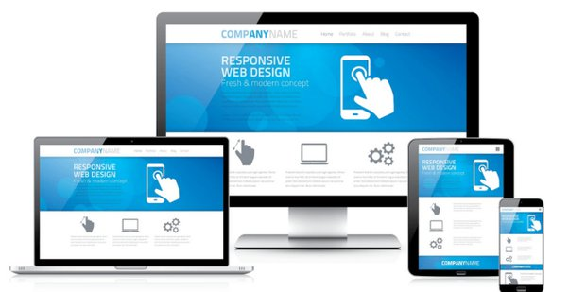
Responsive Designs

Slide 26
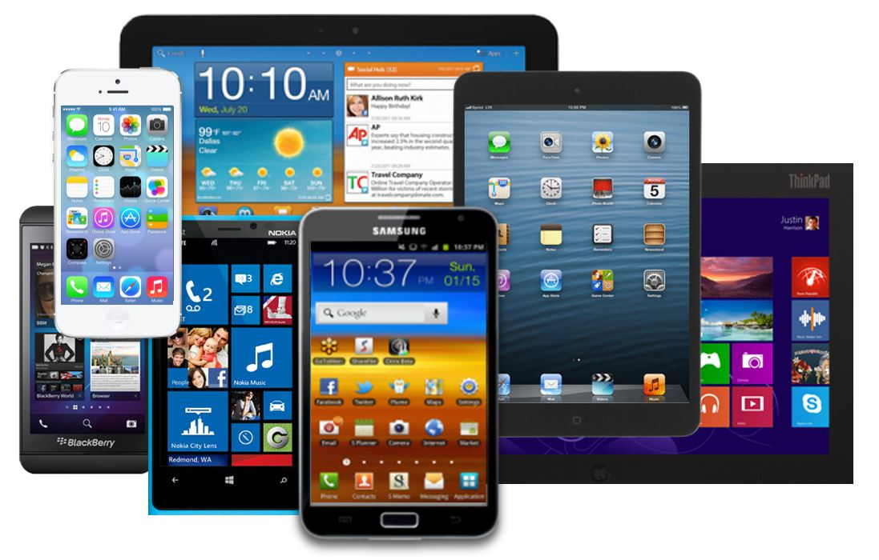
Mobile Devices

Slide 27
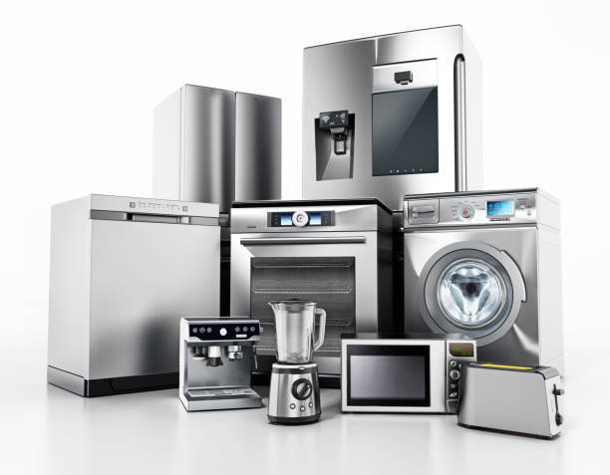
Appliances
Appliances include machines for everyday use in the home (for example, washing machines, microwave ovens, refrigerators, toasters, bread makers, and smoothie makers).

Slide 28
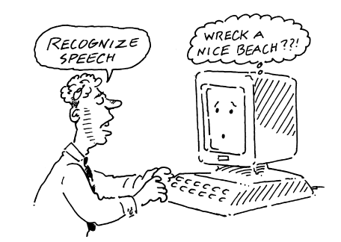
Voice User Interfaces (VUI)
A voice user interface (VUI) involves a person talking with a spoken language app, such as a search engine, a train timetable, a travel planner, or a phone service.

Slide 29
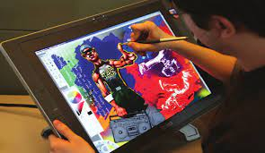
Pen Based Devices
Pen-based devices enable people to write, draw, select, and move objects on an interface using light pens or styluses that capitalize on the well-honed drawing and writing skills that are developed from childhood.

Slide 30
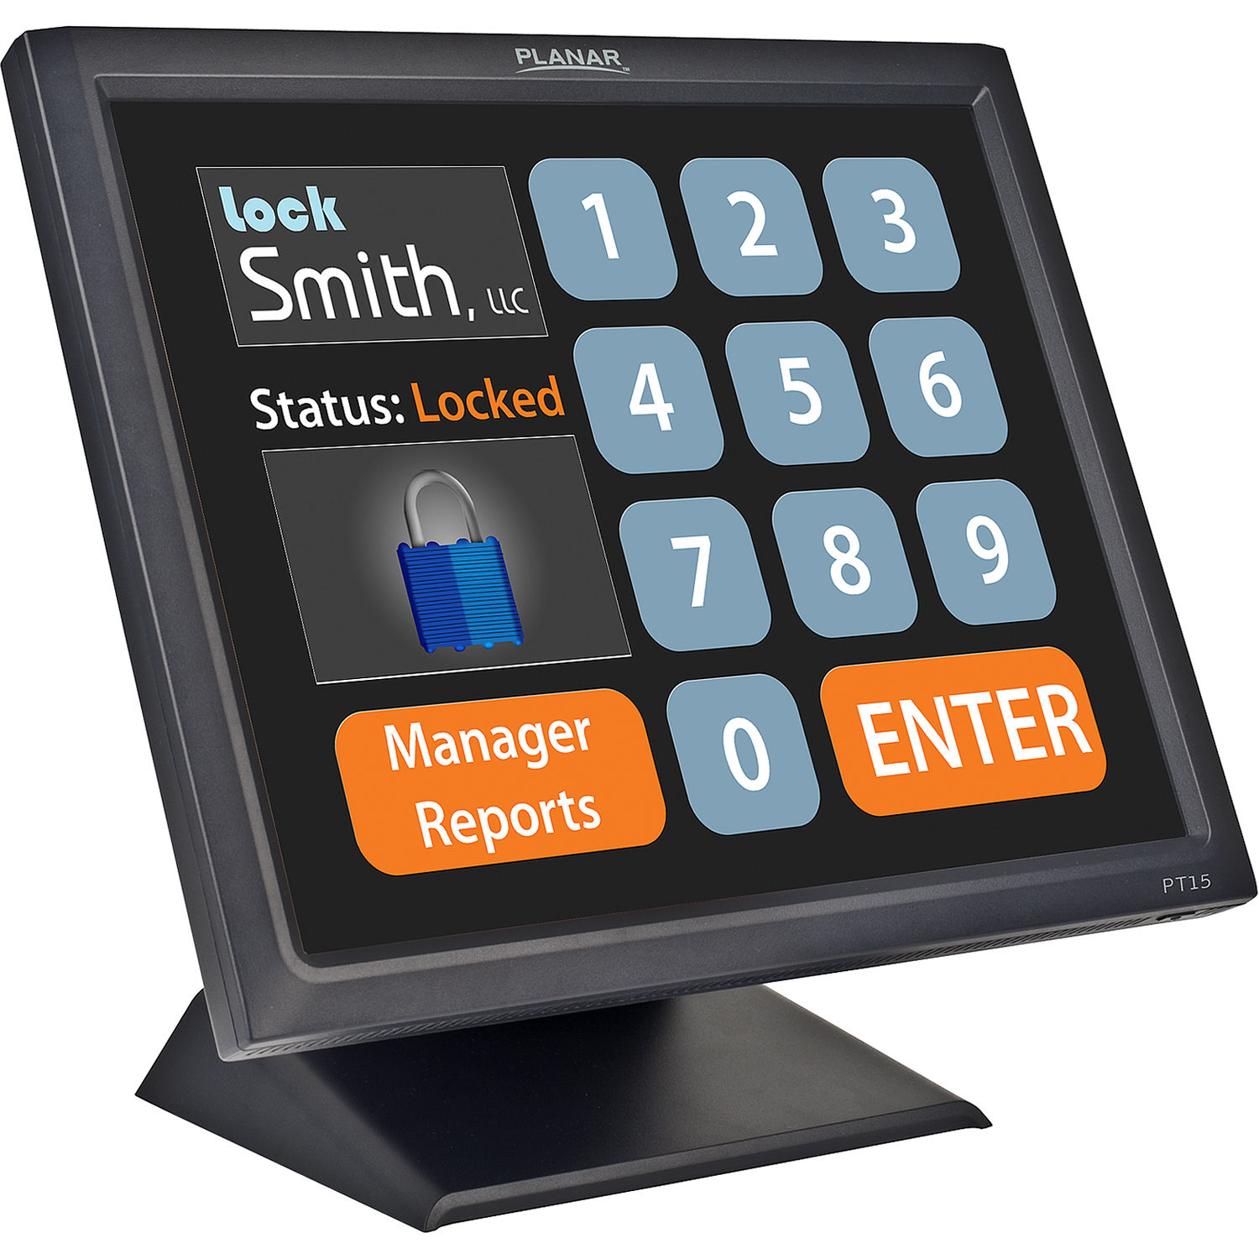
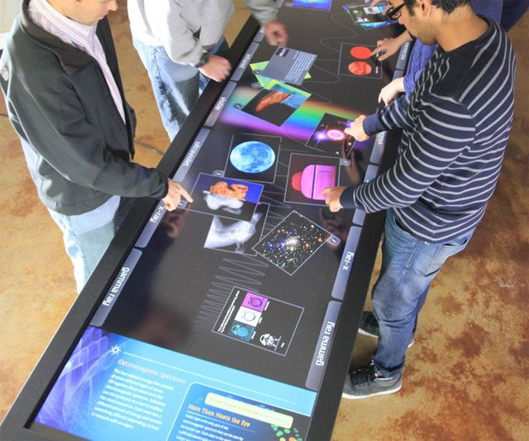
Touch Screen
Single Touch Screens
Multitouch Screens

Slide 31
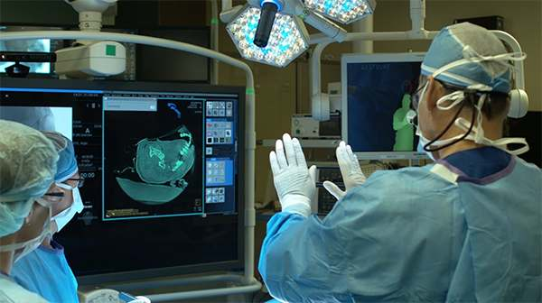
Gesture Based Systems
Gestures involve moving arms and hands to communicate.

Slide 32
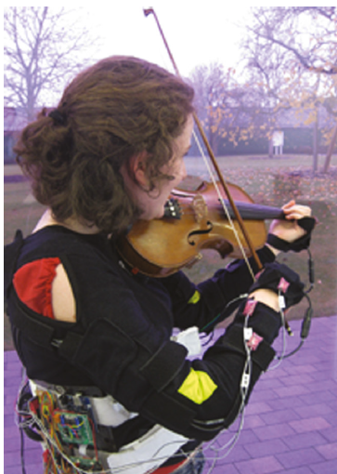
Haptic Interfaces
Haptic interfaces provide tactile feedback, by applying vibration and forces to the person, using actuators that are embedded in their clothing or a device that they are carrying, such as a smartphone or smartwatch.
Vibrotactile feedback can also be used to simulate the sense of touch between remote people who want to communicate.
Ultrahaptics which creates the illusion of touch in midair by ultrasonic waves.
Exoskeletons haptics are also being embedded into clothing.

Slide 33
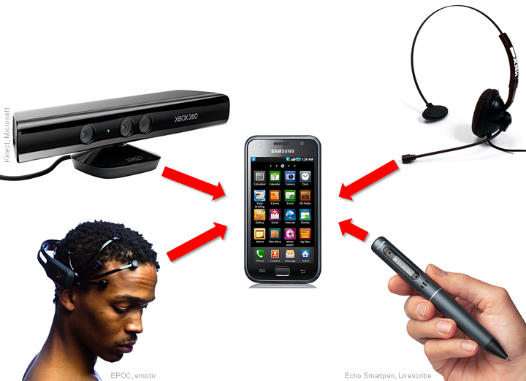
Multimodal Interfaces
Multimodal interfaces are intended to enrich user experiences by multiplying the way information is experienced and controlled at the interface through using different modalities, such as touch, sight, sound, and speech.

Slide 34
Multimodal Interfaces
Interface techniques that have been combined for this purpose include speech and gesture, eye-gaze and gesture, haptic and audio output, and pen input and speech.
The assumption is that multimodal interfaces can support more flexible, efficient, and expressive means of human–computer interaction that are more akin to the multimodal experiences that humans encounter in the physical world.

Slide 35
Sharable Interfaces
Shareable interfaces are designed for more than one person to use.
It provides multiple inputs and sometimes allow simultaneous input by collocated groups
Examples
SmartTable
Circle Twelve’s DiamondTouch

Slide 36
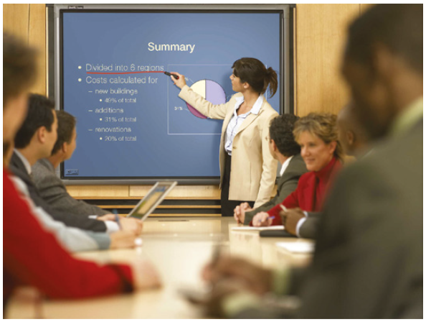
Sharable Interfaces
A SmartBoard in use during a meeting

Slide 37
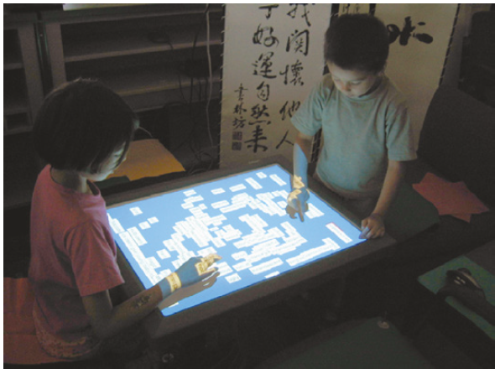
Shareable Interfaces
Mitsubishi’s interactive tabletop interface

Slide 38
Sharable Interfaces
Another type of shareable interface is software platforms that enable groups of people to work together simultaneously even when geographically apart
Examples
Google Docs
Figma
Balsamiq

Slide 39
Tangible Interfaces
Tangible interfaces use sensor-based interaction, where physical objects, such as bricks, balls, and cubes, are coupled with digital representations.
When a person manipulates the physical object(s), it is detected by a computer system via the sensing mechanism embedded in the physical object, causing a digital effect to occur, such as a sound, animation, or vibration

Slide 40
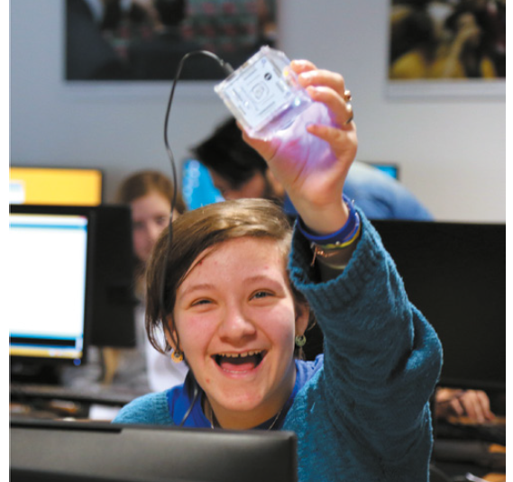
Tangible Interfaces
There is no single locus of control or interaction
Instead of just one input device, there is a coordinated interplay of different devices and objects
There is also no enforced sequencing of actions and no modal interaction.
Magic Cube
(Learn to Code)

Slide 41
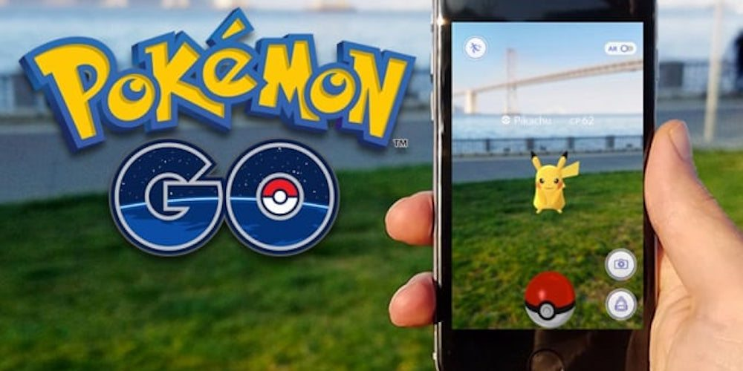
Augmented Reality
Augmented reality (AR) is an enhanced version of the real physical world that is achieved through the use of digital visual elements, sound, or other sensory stimuli and delivered via technology.

Slide 42
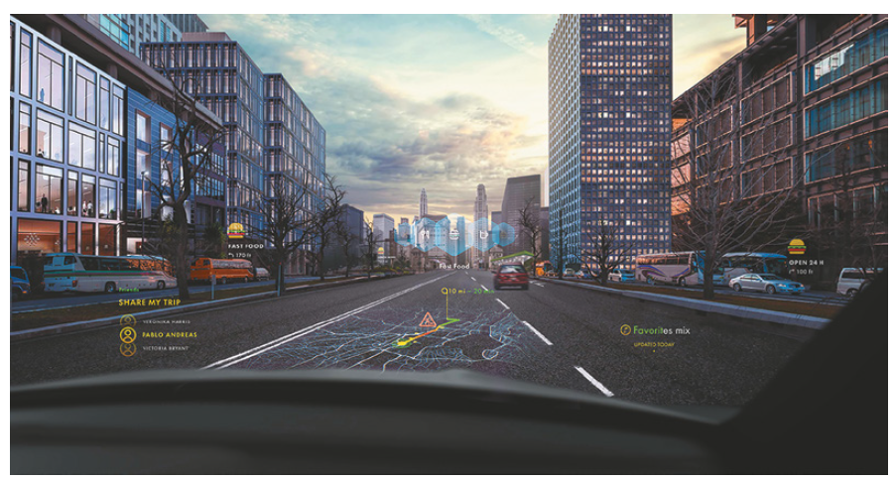
Augmented Reality
Augmented reality overlay used on a car windshield

Slide 43
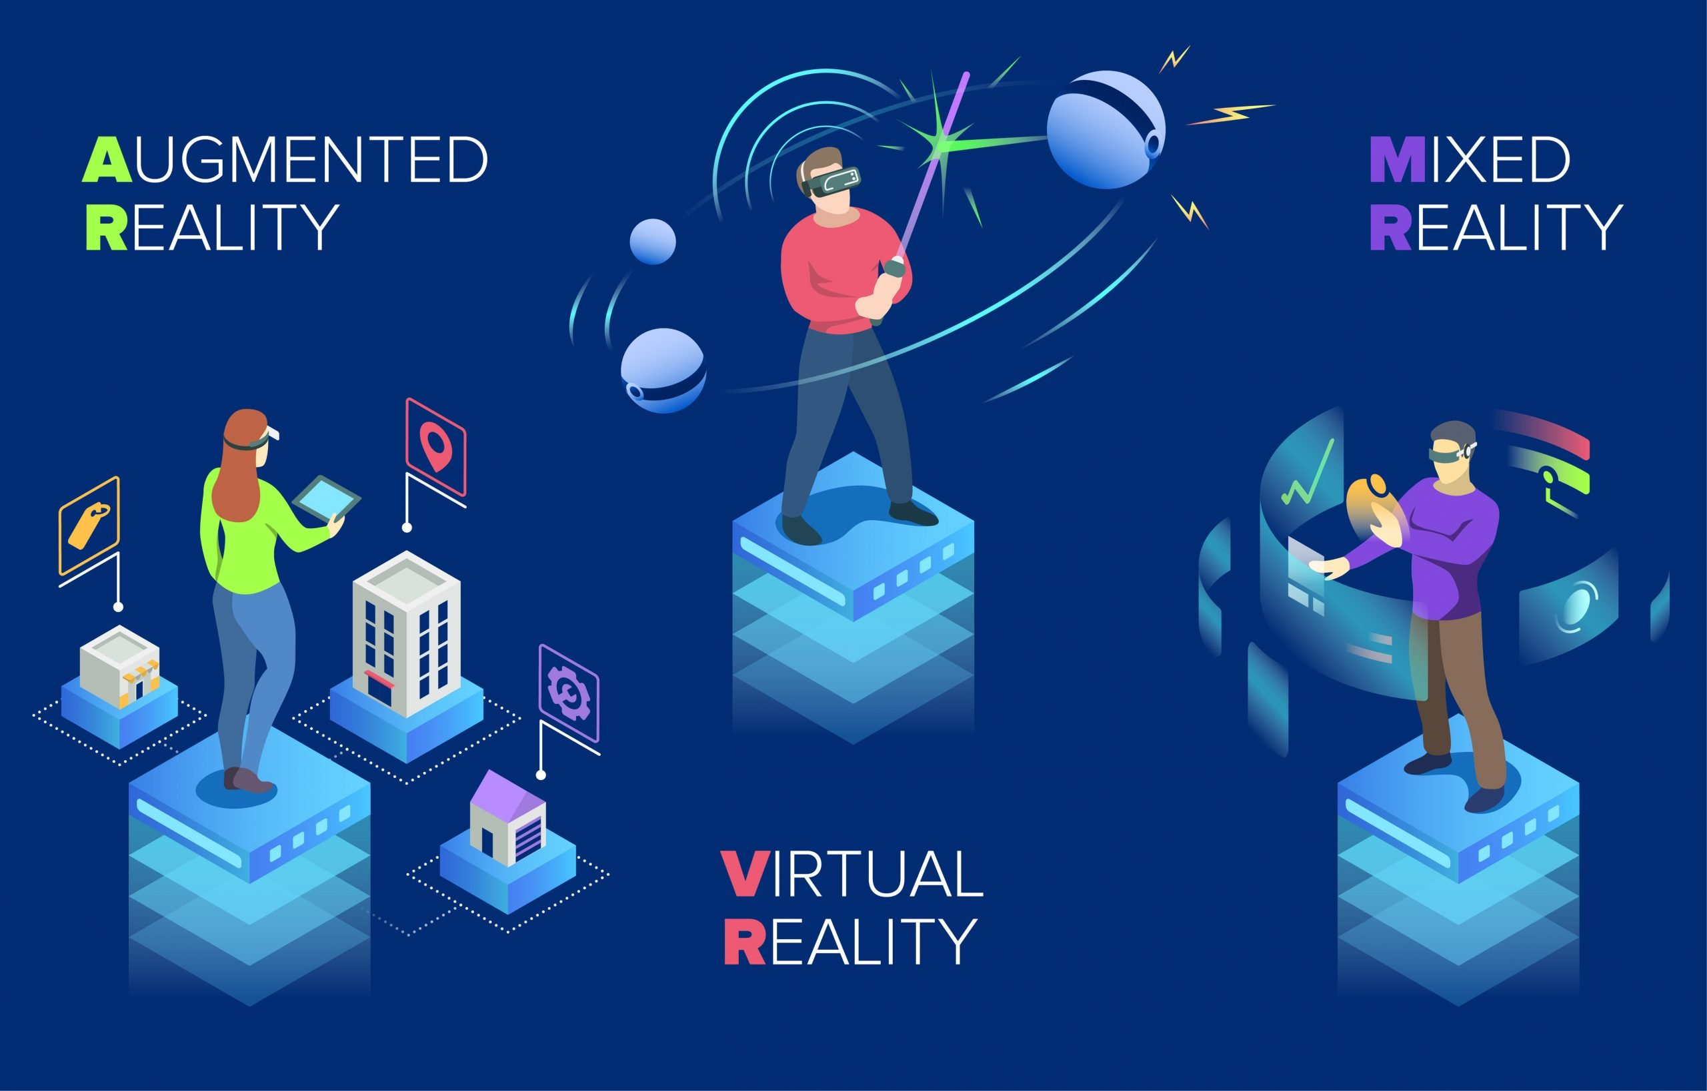
Mixed Reality
Mixed reality is a term used to describe the merging of a real-world environment and a computer-generated one.

Slide 44
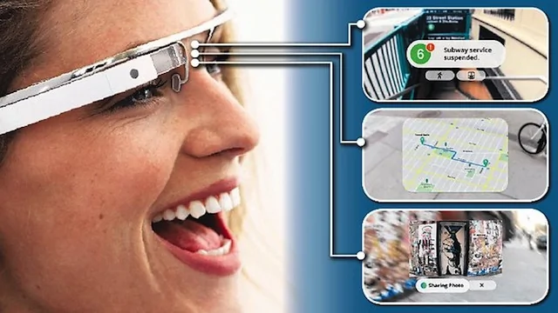
Wearable
Wearables are a broad category of devices that are worn on the body.
These include smart watches, fitness trackers, fashion tech, and smart glasses.
Exoskeleton clothing
Google Glass
Vuzic Blade
Snap’s Spectacles
Talking Shoe

Slide 45
Robots and Drone
Robots have been around for some time, most notably as characters in science-fiction movies,
but they also play an important role as part of manufacturing assembly lines,
as remote investigators of hazardous locations (for example, nuclear power stations and bomb disposal),
and as search and rescue helpers in disasters (for instance in forest fires) or faraway places.
Console interfaces have been developed to enable humans to control and navigate robots in remote terrains, using a combination of joysticks and keyboard controls together with cameras and sensor-based interactions.

Slide 46
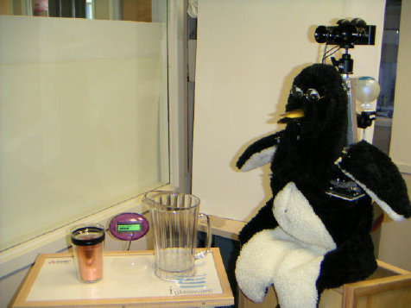
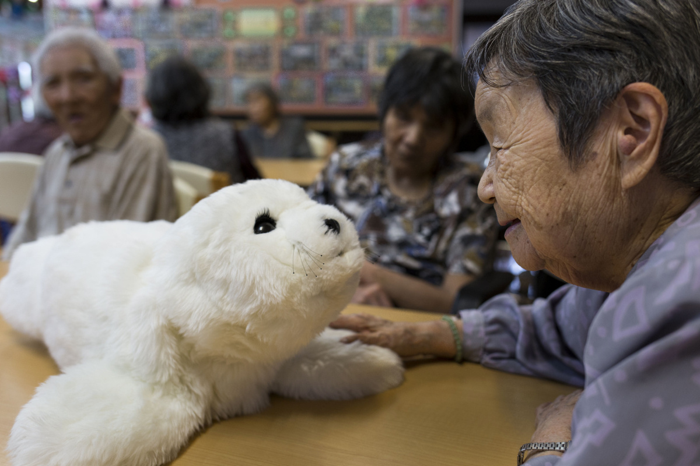
Examples

Slide 47
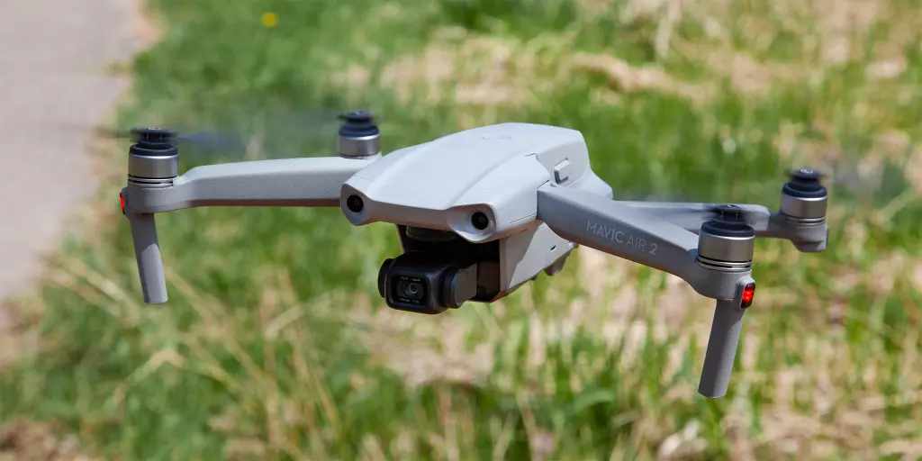
Drones
Drones are a form of unmanned aircraft that are controlled remotely.

Slide 48
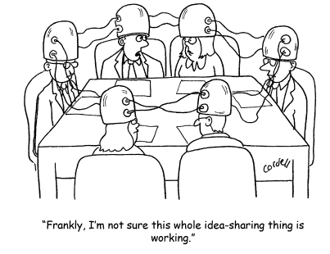
Brain Computer Interfaces
Brain–computer interfaces (BCI) provide a communication pathway between a person’s brain waves and an external device, such as a cursor on a screen or a tangible puck that moves via airflow.

Slide 49
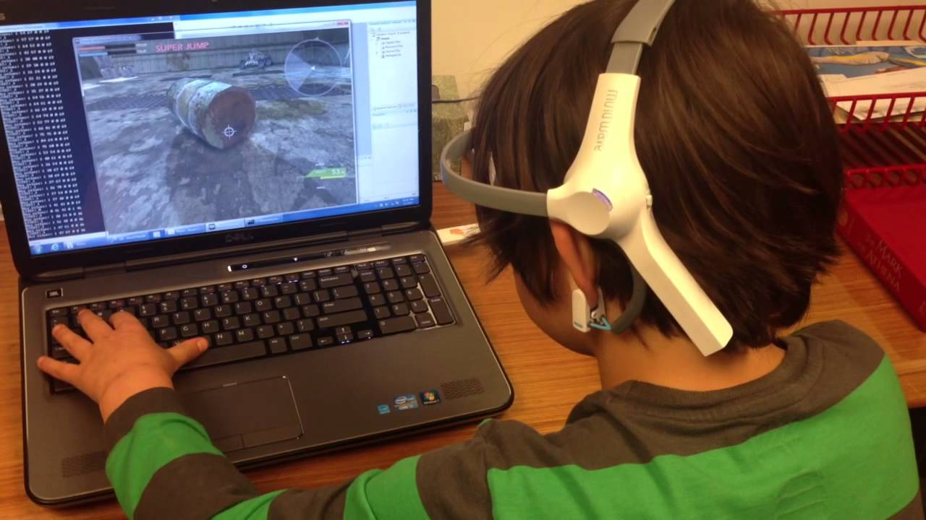
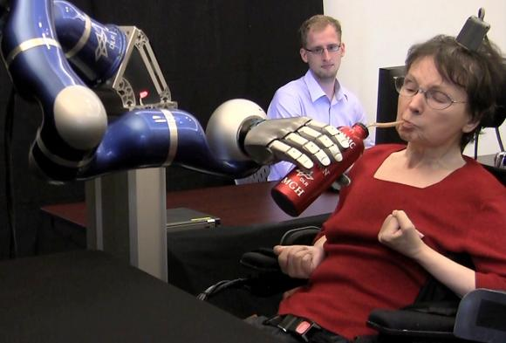
Examples
Brain–computer interfaces have also been developed
to control various games.
to enable people who are paralyzed to control robots

Slide 50
Smart Interfaces
The motivation for many new technologies is to make them smart, whether it is a
smartphone,
smartwatch,
smart building,
smart home,
or smart appliance (for example smart lighting, smart speakers, or virtual assistants).

Slide 51
Smart Interfaces
Smart devices are often used to suggest that the device has some intelligence, and it is connected to the Internet.
Smart devices are automated, not requiring users to interact with them directly
The goal is to make them context-aware, that is, to understand what is happening around them and execute appropriate actions.

Slide 52
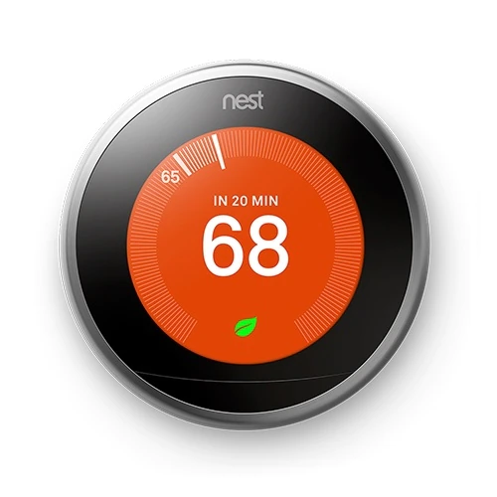
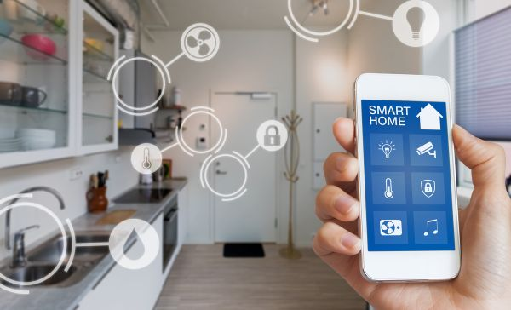
Example
Nest Thermostat
Smart buildings
Human Building Interaction

Slide 53
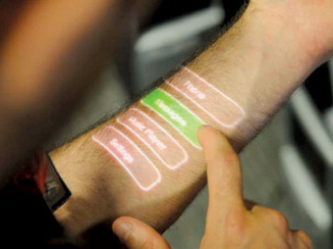
Natural User Interfaces and Beyond
A natural user interface (NUI) is designed to allow people to interact with a computer in the same way that they interact with the physical world , using their voice, hands, and bodies.
NUIs enable users to
speak to machines,
stroke their surfaces,
gesture at them in the air,
dance on mats that detect feet movements,
smile at them to get a reaction, and so on…

Slide 54
Natural User Interfaces and Beyond
An emerging class of human–computer interfaces are those that rely largely on subtle, gradual, and continuous changes triggered by information obtained implicitly from the user together with the use of AI algorithms that are coded to learn about the user’s behavior and preferences.
These are connected with lightweight, ambient, context-aware, affective, and augmented cognition interfaces

Slide 55
Which Interface?
The requirements for the user experience that have been identified will determine
what kind of interface might be appropriate and what features to include.
It will also depend on the interplay of a number of factors, including reliability, social acceptability, privacy, ethical, and location concerns.

Slide 56
Conclusion
Types of Interfaces
Natural Interfaces
Which Interface

